Slide 1
Driving an Agile Peg in a CMMI Hole

Slide 2
Quasi-Agile Context
Most corporations are still fairly traditionally structured
Many software development teams are heading full steam into modern agile development techniques.
This leaves management stuck coping with an organizational and technical paradigm shift that traditional project management practices are inadequate to handle.
In the highly iterative, fast paced, environment characteristic of these agile development projects, traditional approaches to budgeting, testing, quality assurance, requirements gathering, scheduling and estimating, etc. break down.
Managers trying to encourage best practices as recommended by CMMI and SPICE find themselves at odds with developers trying to adopt best practices as recommended by the agile manifesto.

Slide 3
Quasi Agile Context
In the end no one wins.
Because of the constraints of corporate policies and management edicts, developers can’t fully adopt agile practices.
Because the developers do adopt as much of the agile process as they can get away with, team leads find that traditional approaches to management don’t work.
Such projects must succeed in what I call a quasi agile development environment.
In my experience these quasi agile development environments characterize a large percentage of today’s significant software projects. Lack of explicit understanding of this reality, and failure to actively adapt to it, is causing significant problems in many software development organizations.

Slide 4
Agile Manifesto
Manifesto
agile
We are uncovering better ways of developing software by doing it and helping others do it. Through this work we have come to value:
Individuals and interactions over processes and tools
Working software over comprehensive documentation
Customer collaboration over contract negotiation
Responding to change over following a plan
That is, while there is value in the items on the right, we value the items on the left more.

Slide 5
Quasi-Agile
A quasi-agile environment is one where software developers are
implementing agile values and practices
within a traditionally structured organization that has policies and procedures derived from
waterfall concepts
typical CMMI or ISO philosophy

Slide 6
In Theory
Both agile and plan driven approaches have the same goals
The both seek to develop systems
Of high quality
As quickly as possible
With minimum cost
As predictably as possible
Better, Faster, Cheaper

Slide 7
In Practice
Agile
Low overhead, minimal documentation
Aggressive iterative/incremental process
Creative optimizations flexibly tailored to the current environment and staff
Plan Driven
Lots of process overhead and documentation
Waterfall like processes
Standardization across projects

Slide 8
Why
Differences in philosophy about the nature of software development
Agile proponents believe that software development is very unlike manufacturing, building construction, or other activities that deal with physical construction materials.
CMMI has the concept of “institutionalization” at the heart of its philosophy
Differences in philosophy about the goal of Software development
Meet requirements vs. solve business problems

Slide 9
Resulting Differences
Traditional | Agile
Plan entire project upfront | Scope upfront, details increment by increment
Lock in resources, details as early as possible | Lock in resources, details as late as reasonable
All requirements up front | Goals up front, details increment by increment
Resist change, control it, make it difficult | Facilitate change
Use data from past projects to plan current project | Use data from increment 1 to plan increment 2
Document anything that might possibly be useful | Only document things proven to be necessary
Put a process in place to prevent any potential error that could be prevented | Only put processes in place proven to be necessary
Rely on documents, processes, tools, plans | Rely on face to face collaboration

Slide 10
How do you drive an agile peg in a CMMI hole
Barely sufficient processes and documentation
Multi-cultural tolerance
Peaceful co-existence of processes derived from very different philosophies
Focus on the goal of traditional control structures
Show how the goal can be met in innovative agile ways

Slide 11
Barely sufficient processes and documentation
You have to create a test plan, and the corporate template is 20 pages long
Use brief sentences, and lots of N/As
Corporate processes require the use of a defect tracking tool to document defects and their resolution
Use face to face collaboration for the bulk of the tester/programmer interaction, but document selected results in the tool.

Slide 12
Multi-cultural tolerance
Peaceful co-existence of processes derived from very different philosophies
Recognition of the legitimacy of multiple interlocking processes
Management
Development
Testing
Deployment
Support

Slide 13
Multi-cultural tolerance Example
The contract process might require a complete set of requirements up front
The agile development process does not need or want all the details up front
The quasi-agile solution requires peaceful coexistence of a traditional management process with an agile development process
Make sure the business objectives of the project are clear
Go ahead and let the manager get the requirements up front. Just make sure you don’t believe them. Revisit them increment by increment and expect a lot of change.

Slide 14
Focus on the goal
Show how the goal can be met in innovative agile ways
Documentation
Test cases
Process Improvement
Iteration retrospectives
Gated processes, “design complete”
Real goal is that the project manager has enough data to give more reliable estimates of cost, timeframe, and risk that at project inception.

Slide 15
Focus on the goal
Show how the goal can be met in innovative agile ways
Inspections

Slide 16
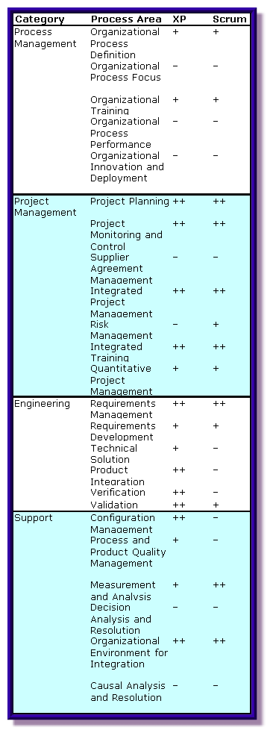
Process Areas
Agile methods do address most of the CMM process areas

Slide 17
CMMI - How versus What
The CMM doesn't state how you have to do things, it only states what an assessor must look for
CMMI has goals like “There's a process in place so everybody understands the requirements.” If you could show an assessor that instead of a requirements list, the user and the developer actually have a conversation, and you could easily get some assessors, not all, by any means, to say that's fine

Slide 18
Reality
It is the cultures represented that are incompatible.
Technically CMMI is compatible with Agile practices
Integrating the two gives a Quasi-Agile Development Environment

Slide 19
Institutionalization
When considering process documentation, the element that is missing from agile methodologies, which is crucial for the SW-CMM, is the concept of institutionalization, i.e., establishing the culture that "this is the way we do things around here."
The key process areas in the CMM are structured by common features that deal with implementing and institutionalizing processes. The institutionalization practices for each key process area map to all the goals within the area, so a naive agile implementation that ignored these cultural issues would fail to satisfy any CMM key process area.
Mark C. Paulk, Software Engineering Institute

Slide 20
Fundamental Flaw
There's a fundamental assumption in the CMMI that processes can be repeatable, and that they are predictive processes, basically not empirical processes, says Michael Spayd, a principal with Cogility Consulting Solutions and a former CMM process assessor. That is the fundamental flaw in the CMMI, and that's actually why I don't personally believe in level 4 and 5. They are ridiculous and do not create value
Stephen Swoyer

Slide 21
Deep, Fundamental Divide
Cannot leave two distinct cultures at war with each other
Must forge a Local Manifesto based on shared goals, not practices
You will not get agreement on best practices unless you first get an agreement on shared goals and corporate axioms
The best practices will evolve over time

Slide 22
Cowboy Programmer?
Despite the outward appearances, Agile development does not mean a return to the days of the cowboy programmer. These techniques are discipline-oriented just as the practices described in CMMs. They do, however, have a different philosophy and approach to achieving the goals of the CMMI and can be integrated without compromising the framework.
David Kane

Slide 23
Rigid, Bureaucratic vs. Immature, Undisciplined
While an entrepreneurial Silicon Valley company has one culture, a space shuttle avionics team has another.
Rather than recognizing the inherent differences between people, project teams, and organizations, we denigrate those who have different cultures by labeling them unprofessional, immature, or undisciplined. Or conversely, we label them bureaucratic, rigid, and closed-minded.
A mismatch of culture to methodology will hurt the project

Slide 24
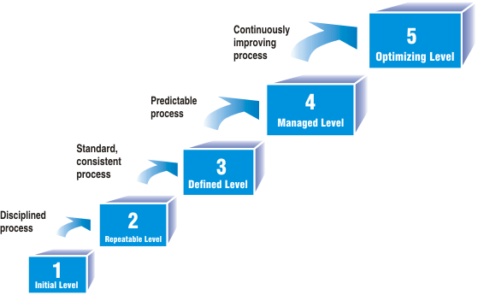
My Observations

Slide 25
Real Process Improvement
The cost of a process step must always be weighed against the cost of the implementation and the risk it mitigates

Slide 26
How do you drive an agile peg in a CMMI hole
Barely sufficient processes and documentation
Multi-cultural tolerance
Peaceful co-existence of processes derived from very different philosophies
Focus on the goal of traditional control structures
Show how the goal can be met in innovative ways

Slide 27
Agile Development
Seeks to satisfy the customer through early and continuous deployment of software that adds value to the client
Welcomes changing requirements, even late in development, if that is what is needed for the customer’s competitive advantage.
Produces working software on schedule every few weeks.
Requires that business people and developers work together daily throughout the project.
Promotes face-to-face communication as the most efficient and effective method of conveying information to and within a development team

Slide 28
Agile Development
Uses working software as the primary measure of progress
Promotes sustainable development. The sponsors, developers, and users should be able to maintain a constant pace indefinitely.
Pays continuous attention to technical excellence and leverages good design to enable agility
Demands simplicity. Always use the simplest thing that could possible work.
Relies on self-organizing teams to generate the best architectures, requirements and code in the most efficient way.
Asks the team to reflect at regular intervals on how to become more effective.

Slide 29
Agile Development
Has testing at it’s heart and soul
Encourages test first development.
Automates both unit and system level tests so that regression tests are continuously being run.
Uses tests as the official detailed requirements.
Requires that the client be an integral part of the team and give continuous feedback on all aspects of quality.
Deploys software early and frequently to ensure that the system meets all functional and quality requirements necessary to provide value to the stakeholders.
Integrates test professionals into the software development team.

Slide 30
Fixed Delivery Dates
Delivery dates are fixed
Scope is negotiated as necessary
Trust
Predictibility
Feedback

Slide 31
Frequent, Small Releases
Based on iterative development
Very good for the development team
Time consuming, albeit necessary, for the client
Increment
I
I
I
I
n
n+1
n+2
n+3
Domain Analysis
light activity
Application Analysis
Application Design
Class Development
Integration and regression testing
heavy activity

Slide 32
Testing Increments
S I1 I2 I3
Develop and test I1
S I1 I2 I3
Develop I1
Develop I2
Test I1

Slide 33
Quasi Agile Principles
Whenever there is a problem have a conversation
Always use the lightest weight possible mechanism to solve the problem
Face to face communication is faster, cheaper, higher bandwidth, and less ambiguous than written documentation.
Low tech solutions are faster, cheaper, and more likely to be used that complicated hi-tech solutions.
The cost of a process step must always be weighed against the cost of the implementation and the risk it mitigates
Always give simple, low tech solutions a chance, but use a more complex solution if needed.

Slide 34
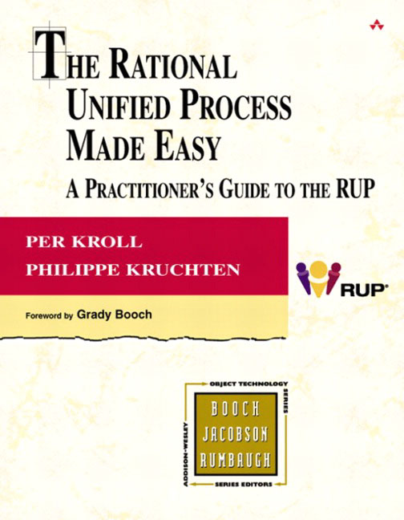
Process Spectrum
Waterfall XP

Slide 35
Process Spectrum
Agile
Waterfall XP

Slide 36
Extreme
Testing
Unit test run 100% al the time
Peer reviews
Pair programming
Customer involvement
On-site, daily.

Slide 37
Extreme
Component integration
Often/Continuous
Time to market.
Frequent small releases.
Design
Continuous refactoring
Simplicity
The simplest thing that could possibly work.

Slide 38
Balancing Agility and Discipline
Plan Driven Agile
Personnel
Less skilled – Highly Skilled
Criticality
Many lives, Single life, Essential Funds, Discretionary funds, Comfort
Project Size
300, 100, 30, 10, 3
Culture
Requires Order, Thrives on Chaos
Dynamism
Very stable requirements, Highly volatile requirements

Slide 39
Balancing Agility and Discipline
Plan Driven Agile
Industry oversight
Heavily regulated, somewhat regulated, unregulated
Hardware dependencies
Embedded, custom attached devices, desktop application
Organizational culture
Suit and tie, business casual, jeans
Industry type
Commercial businesses; Hi tech: aerospace, software
Funding capability
Deep pockets, standard funding, shoestring budget
Organization size
Huge: government; Small: start up
Stakeholder interaction
Impersonal, Formal: document based; Personal: collaborative, face to face

